Slide 1
What’s New in Visual Studio 2017
Umamaheswaran Manivannan
Senior Software Engineer
@UMW1990

Slide 2
Performance improvements
A new setup experience
Start Visual Studio faster
Decrease solution load time
Faster on-demand loading of extensions

Slide 3
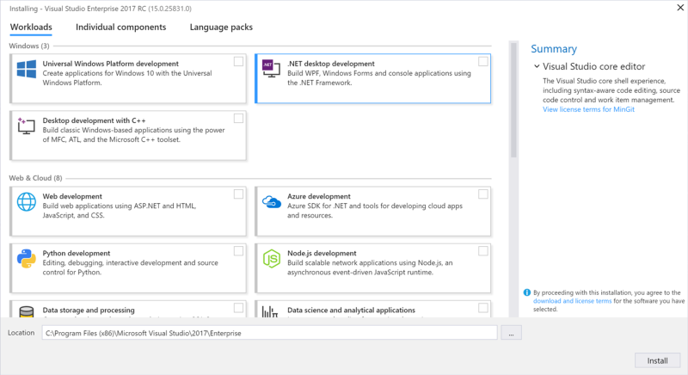
Faster installation - Install workloads

Slide 4
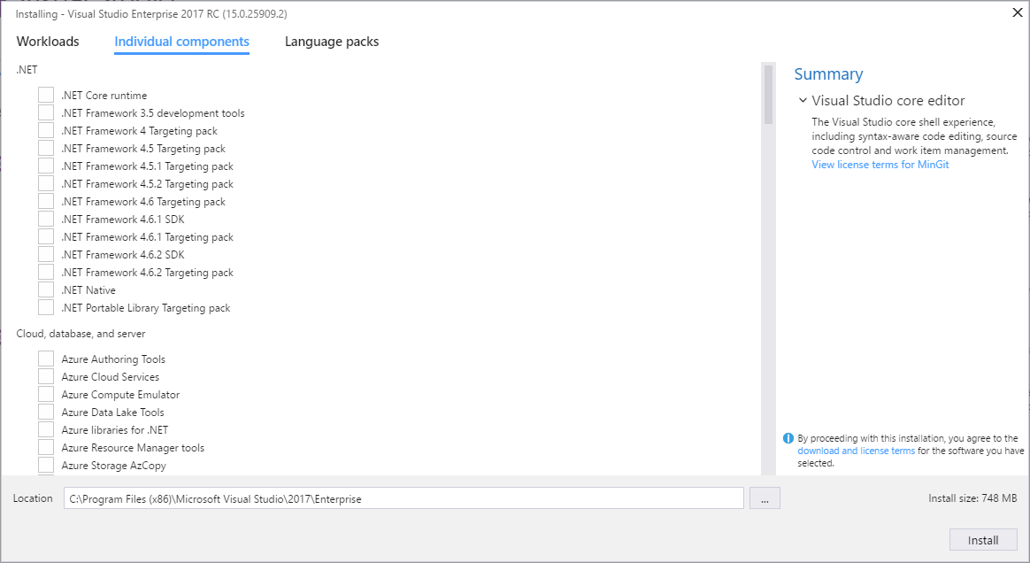
Install individual components

Slide 5
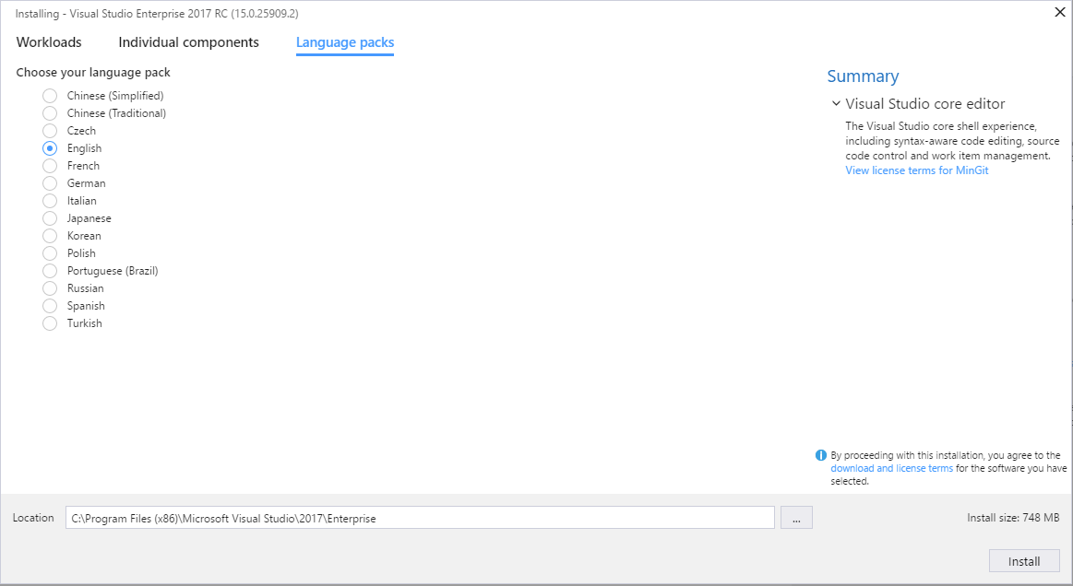
Install language packs

Slide 6
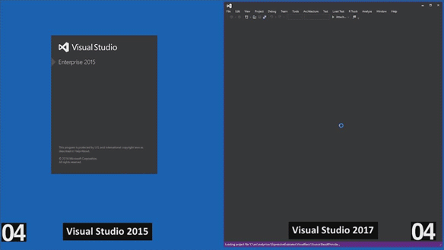
Visual Studio 2017 is up to 4x Faster than Visual Studio 2015

Slide 7
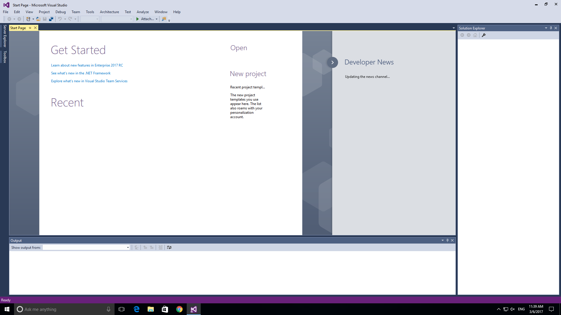
Start Visual Studio faster

Slide 8
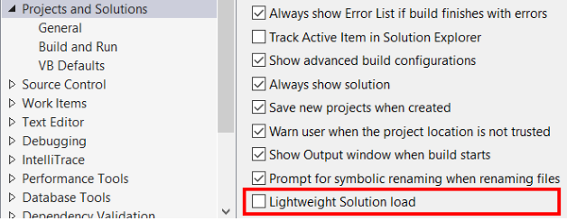
Decrease solution load time

Slide 9
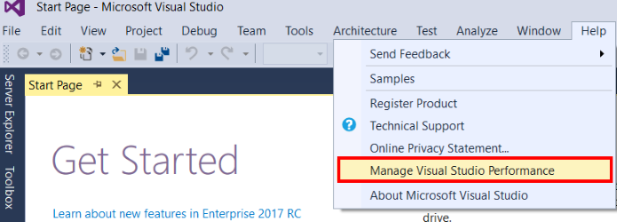
Faster on-demand loading of extensions

Slide 10
Productivity improvements
Sign in across multiple accounts
Manage your extensions with Roaming Extensions Manager

Slide 11
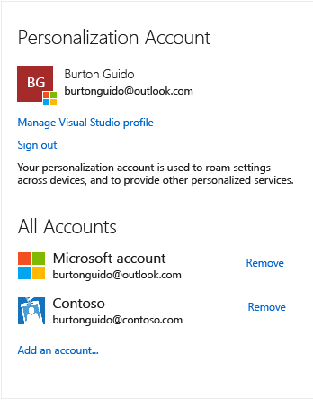
Sign in across multiple accounts

Slide 12
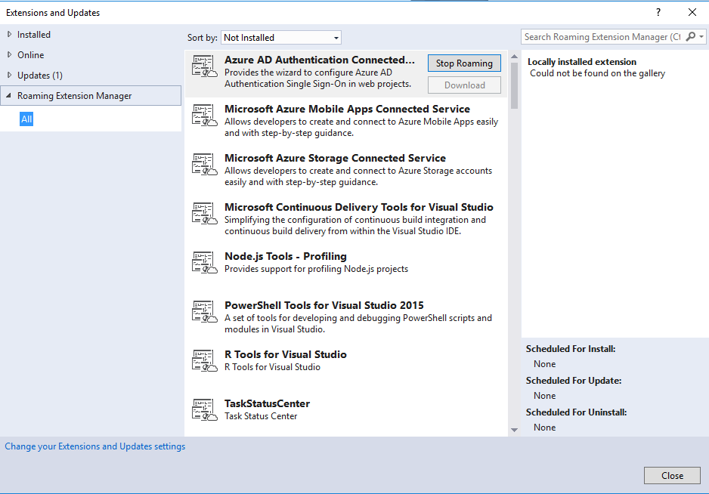
Roaming Extensions Manager
The Roaming Extension Manager helps us keep track of all your favourite extensions across all of our development environments.
Notes:
Roaming your extensions keeps track of the extensions you have installed by creating a synchronized list in the cloud.

Slide 13
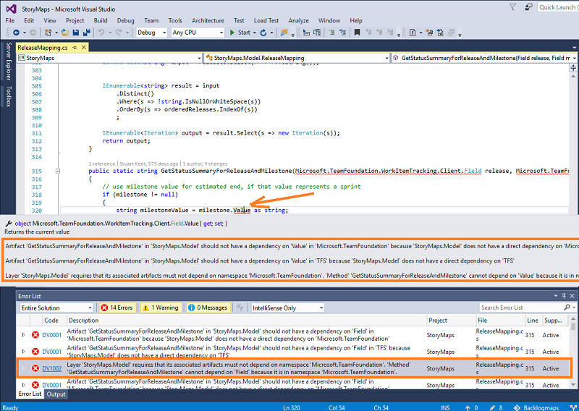
Live architecture dependency validation

Slide 14
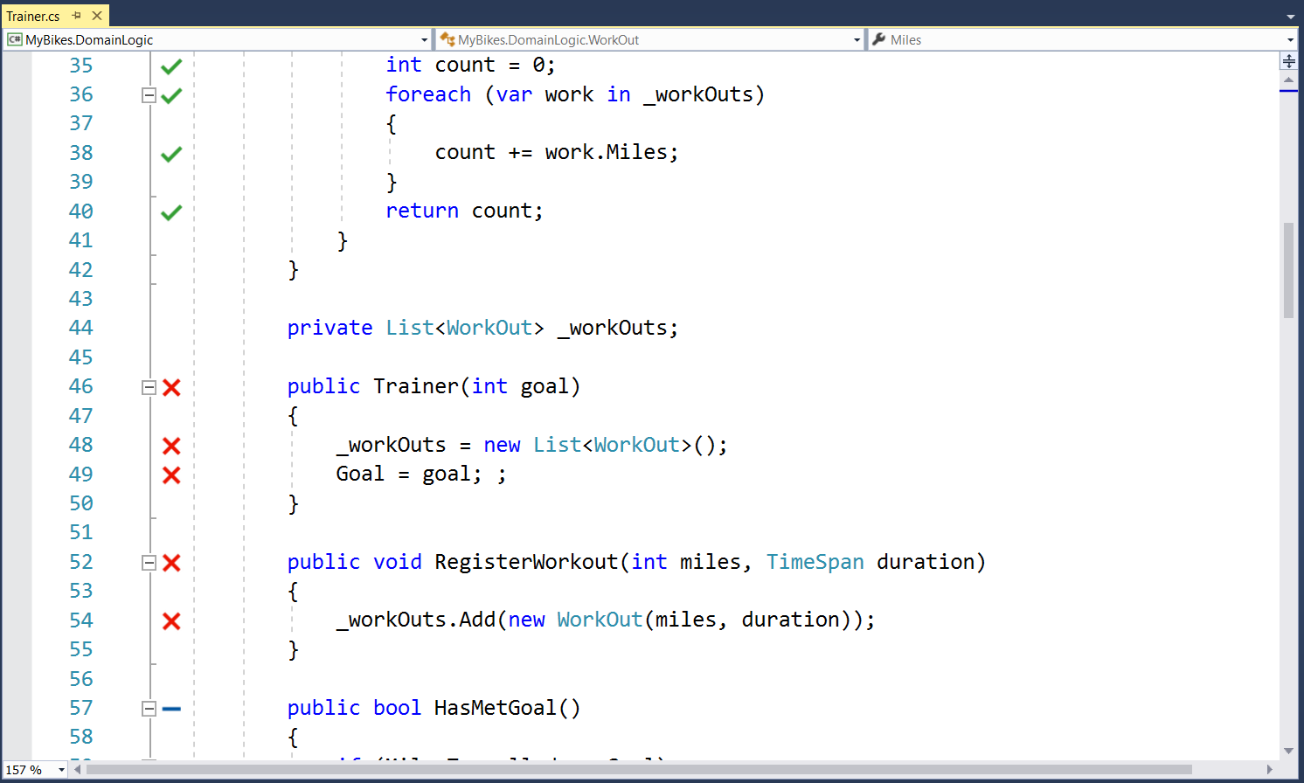
Live unit testing
Visualizes unit test results and code coverage live on the editor, while you are coding.

Slide 15
Thank you!!

